Slide 1
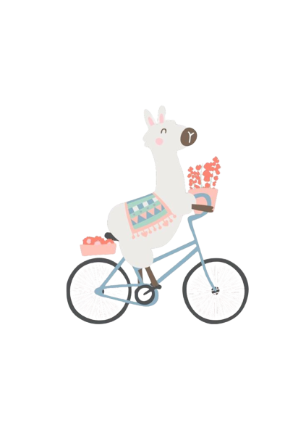
Sales Analysis
LAMA BIKEs
Lara Jarnagin | Arzu Rahimli | Muksana Khatun | Alice Sabeti
07/09/2022

Slide 2

LAMA BIKEs
Created: 2011
Business sector: Retail Bike sales
Total revenue: $177,133,85 (2016)
Products: Accessories, Bike, Clothing
Market: Canada, US, Europe (France, Germany, UK)
Segmentation: Young (<25), Young Adult (25-34), Adults (35-64), Seniors (64+)

Slide 3
Agenda:
Which sub-category has the best performance for the following categories:
The greatest number of units sold
The greatest amount of revenue generated
Which sub-category has the worst performance for the following categories:
The least number of units sold
The least amount of revenue generated
For the sub-category above, which product had:
The least number of units sold
The least amount of revenue generated
Which day did Europe had the:
Greatest amount of revenue generated
Greatest amount of units sold
Appendix

Slide 4
Key findings:
The greatest number of units sold is 514,051 (Tires and Tubes)
The least number of units sold is 2,412 (Bike stands)
The greatest amount of revenue generated is $33,150,708 (Road bikes)
The least amount of revenue generated is $147,171 (Socks)
The least number of product sold is Mountain-500 Black, 2 (40 units)
The greatest number of units product is Water bottle-30 oz (162,051 units)
The least amount of revenue generated is $19,287 (Mountain-500 Black, 2 )
The greatest amount of revenue generated is $3,810,023 (Road-150 Red, 62)
Greatest amount of revenue generated in Europe is $1,067,212.00 (19th day)
Greatest amount of units sold in Europe is 15407 units (18th day)

Slide 5
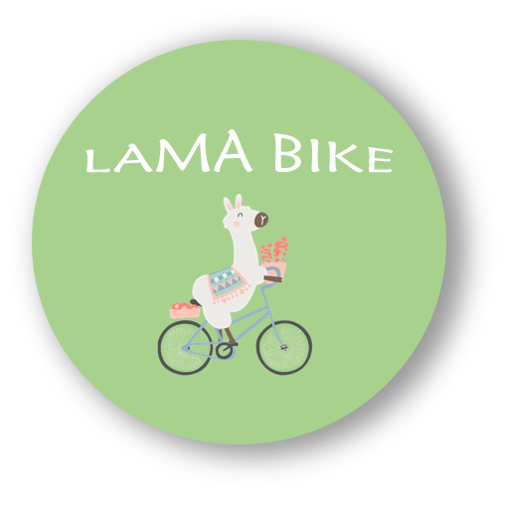
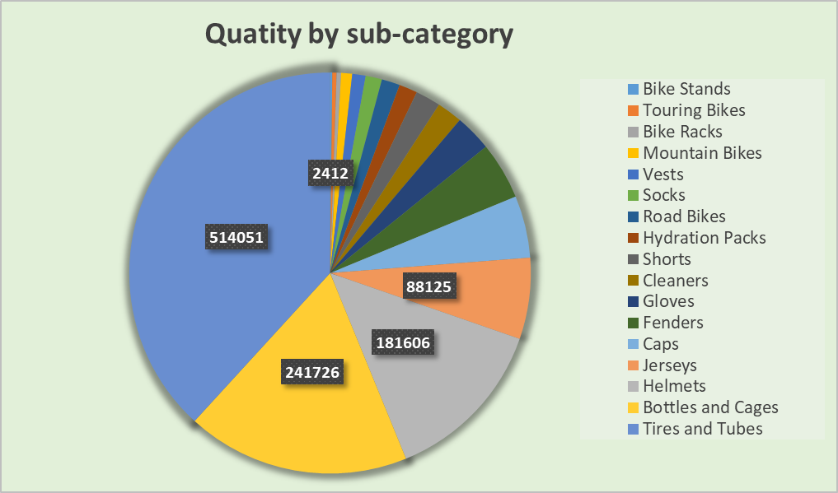
Sales performance of sub-category by quantity
The greatest number of units
The least number of units sold
Criteria | Sub-category | Quantity
The greatest number | Tires and Tubes | 514,051
The least number | Bike stands | 2,412

Slide 6
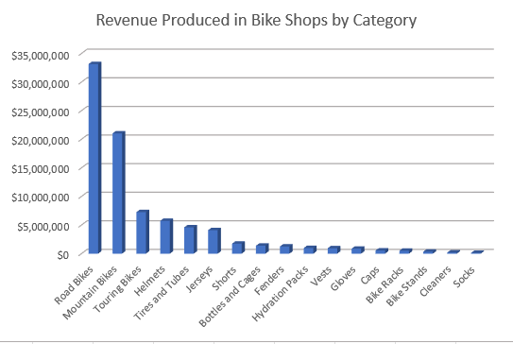
The greatest and least revenue performance by sub-category
The greatest amount of revenue generated
The least amount of revenue generated
Criteria | Sub-category | Amount
The greatest amount | Road bikes | $33,150,708
The least amount | Socks | $147,171

Slide 7
For the sub-category above, which product had:
The least number of units sold
The least amount of revenue generated
Criteria | Product category | Quantity
The greatest amount ordered | Water bottle-30 oz | 162,051
The least amount ordered | Mountain-500 Black, 2 | 40
Criteria | Product category | Amount
The greatest amount | Road-150 Red, 62 | $3,810,023
The least amount | Mountain -500 Black, 52 | $19,287

Slide 8
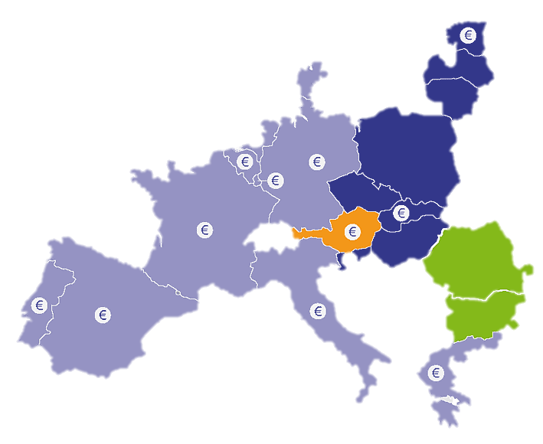
EUROPEAN MARKET ANALYSIS

Slide 9
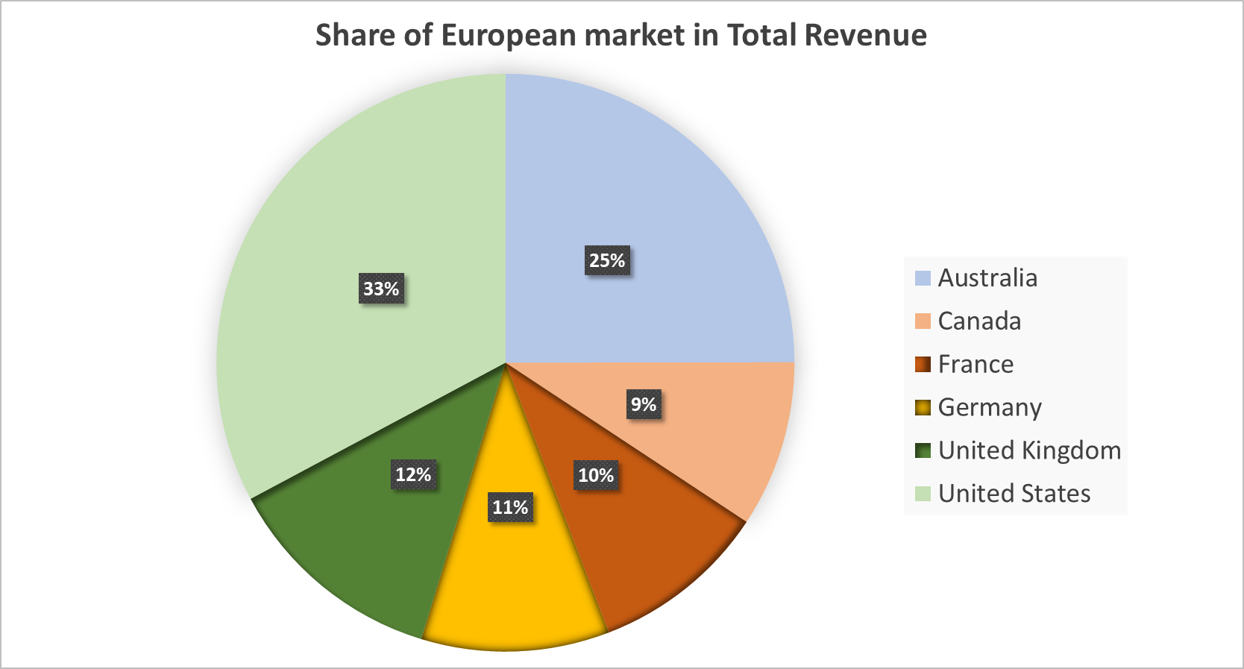
Share of European market in total revenue is approximately 33%

Slide 10
Which day did Europe had the:
Greatest amount of revenue generated
Greatest amount of units sold

Slide 11
The 19th had the greatest amount of revenue generated = $1,067,212.00 for France, Germany and the UK
The 31st was the least amount of revenue = $462,456.00 for France, Germany and the UK

Slide 12
Greatest amount of units sold was on the 18th of each month at 15407
The least amount of units sold was on the 31st at 6864

Slide 13
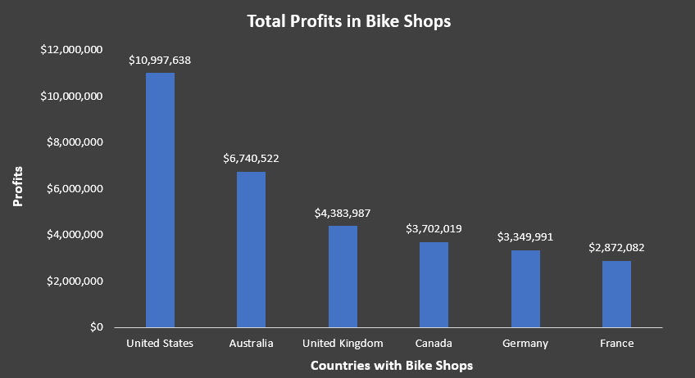
The U.S. had the most profits for bike sales likely due to population differences

Slide 14
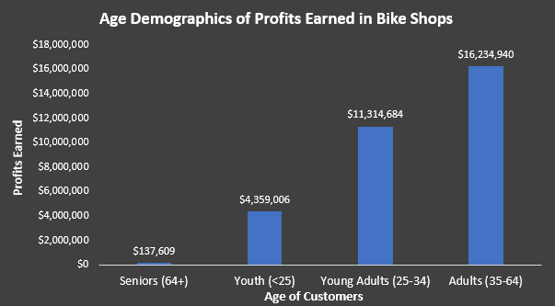
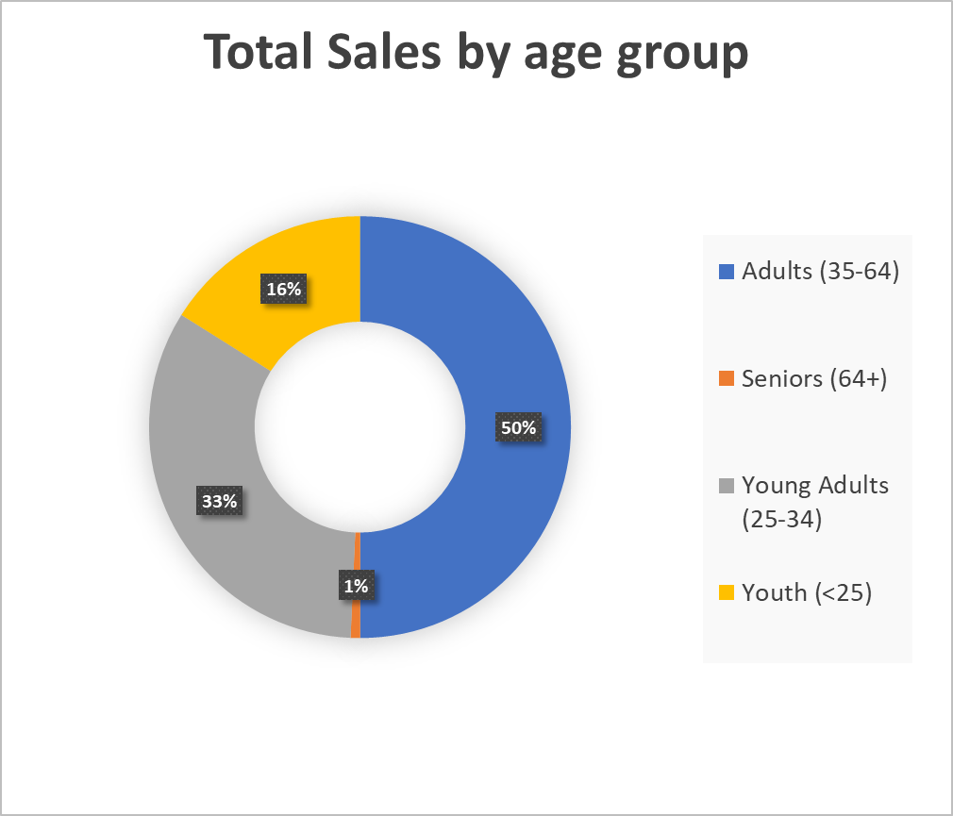
Adults (35-64) were the largest group of individuals making purchases at bike stores

Slide 15
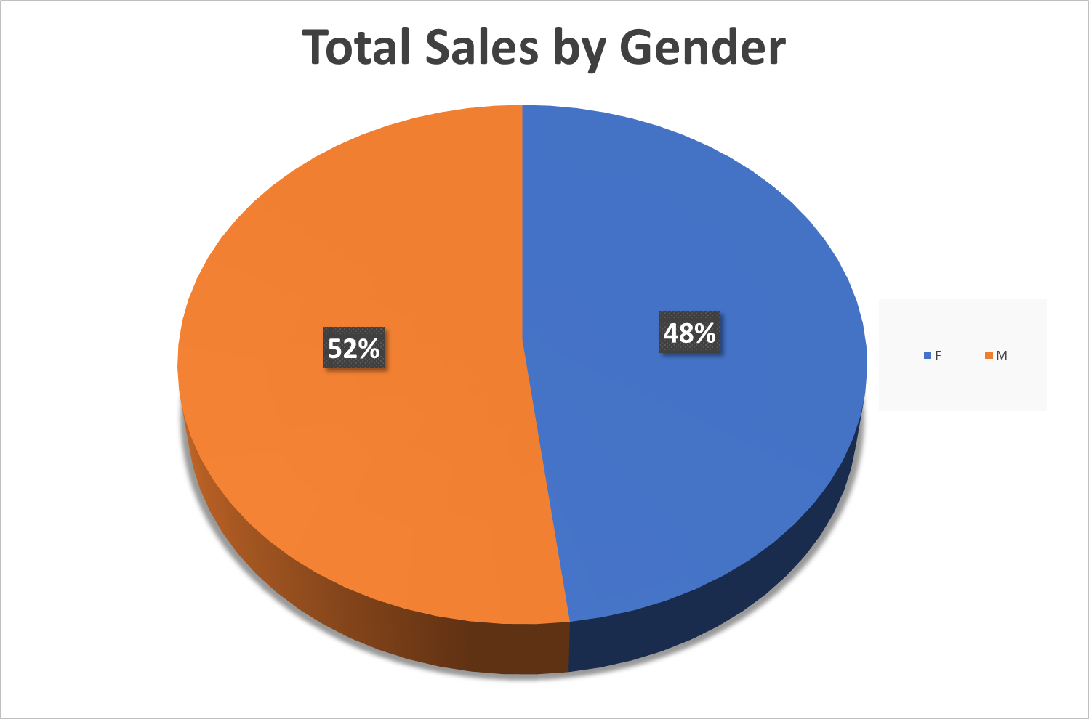

Slide 16
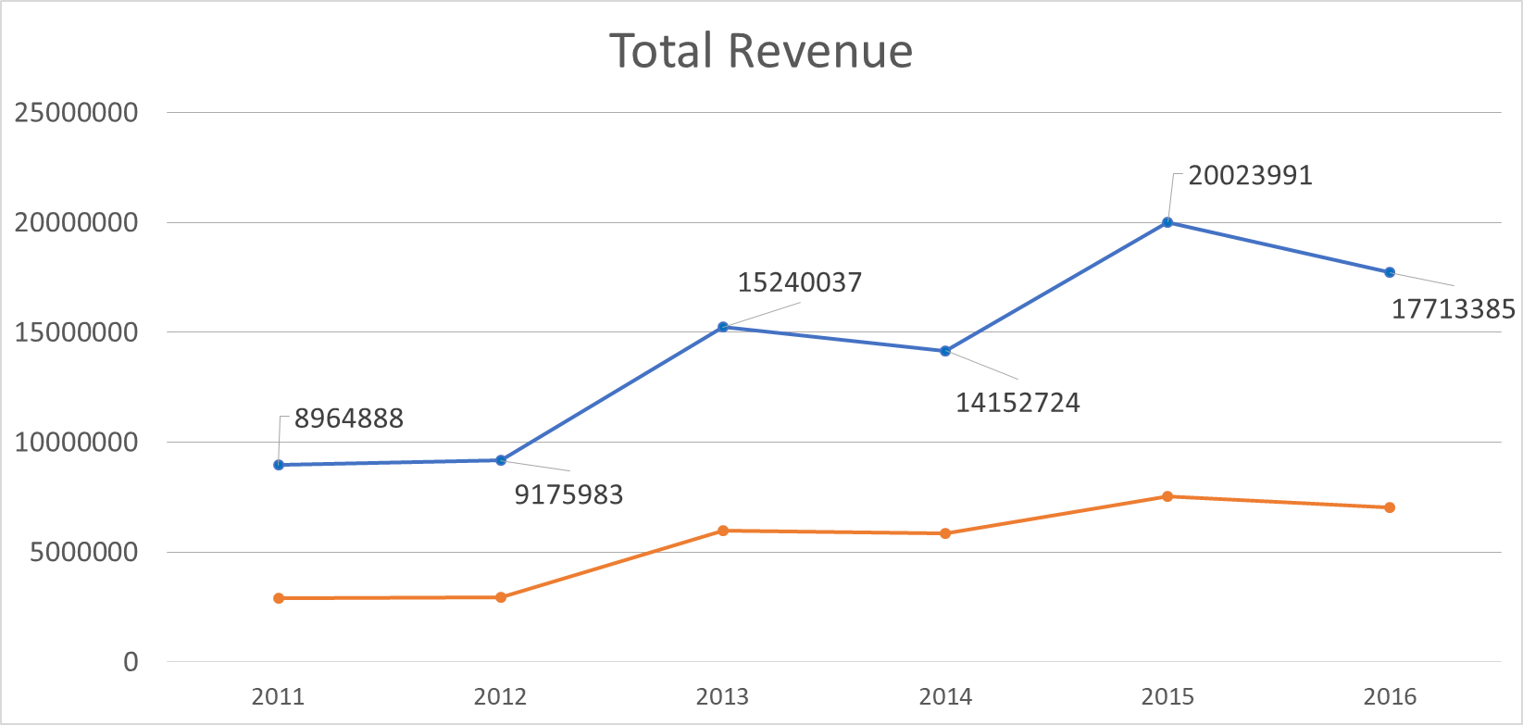

Slide 17
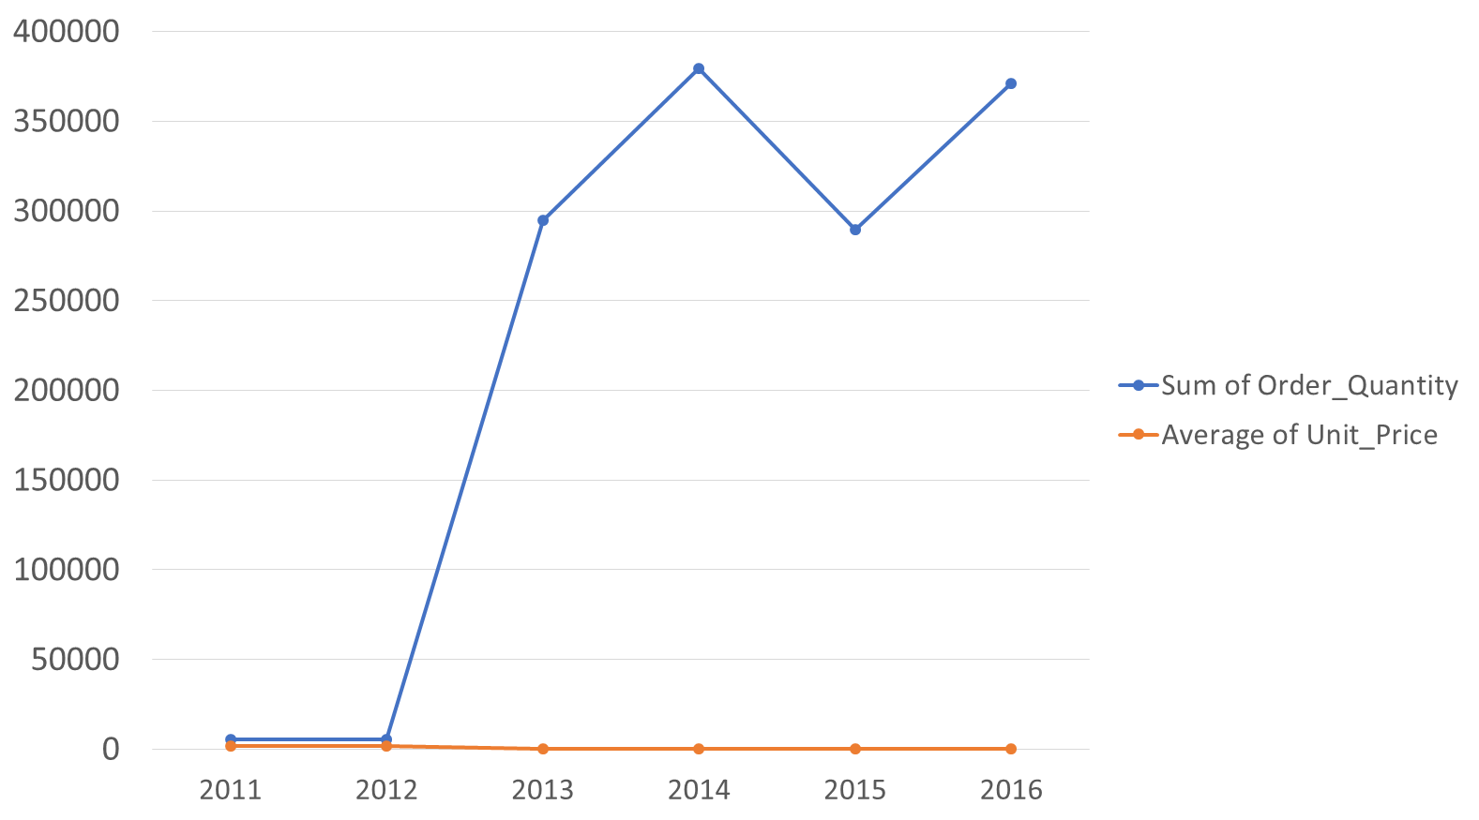
Change in revenue over the time is the result of change in the quantity

Slide 18
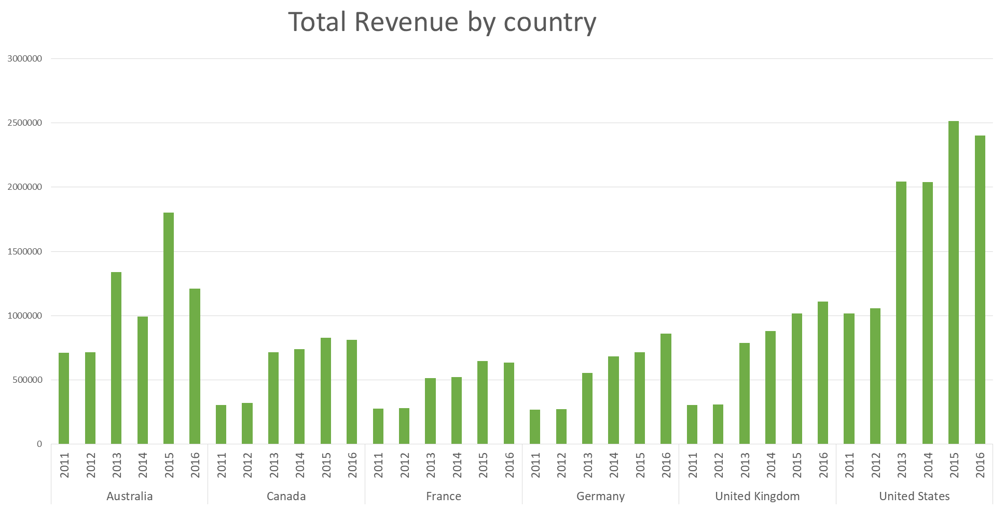

Slide 19
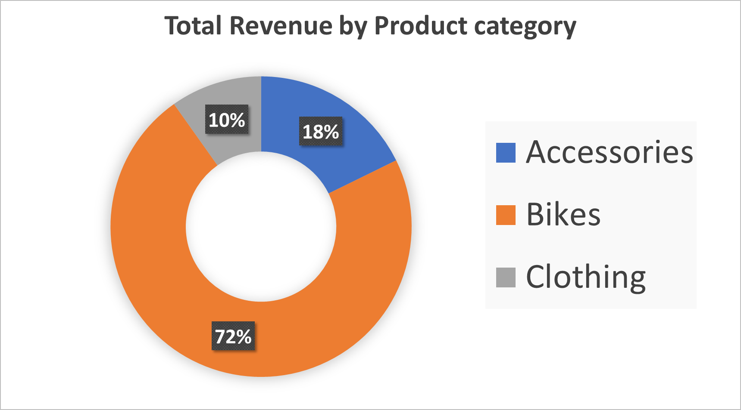

Slide 20
THANK YOU FOR ATTENTION

